Slide 1







MARCH 2026
12 and 13
FCM/UNICAMP AUDITORIUM
Promotion
Support

Slide 2


Presentation Title
Names of the Researchers
Professional Affiliation / Teaching and/or Research Institution
cancerthera.org.br

Slide 3
Exploratory-Simulated Evaluation of New Molecular Markers in Nuclear Medicine Applied to Cancer
Maria Silva¹, João Pereira², Ana Costa¹, Roberto Almeida³
¹ Fictitious Institute of Nuclear Medicine ² Imaginary Center for Oncological Research ³ Invented University of Biomedical Sciences
cancerthera.org.br

Slide 4

Conflict of Interest
  The authors declare that they have no conflicts of interest related to the development of this work.
  Activities were conducted in accordance with good scientific and ethical practices.
RESPONSABILIDADE
cancerthera.org.br

Slide 5
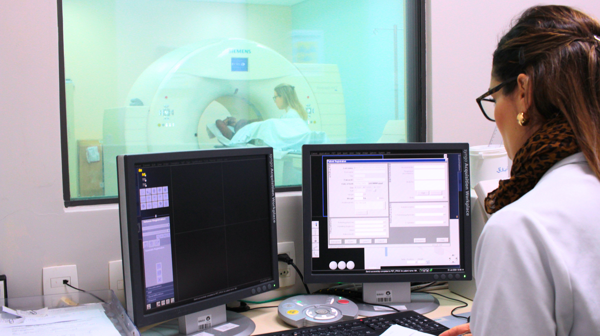
Introduction and Objective
Nuclear Medicine has expanded its role in the diagnosis, staging, and therapeutic monitoring of solid tumors.
This study evaluates the performance of an emerging molecular marker, focusing on its ability to detect early metabolic changes.
Methodology
  The evaluation was conducted in a cohort of patients undergoing PET/CT using the radiopharmaceutical of interest.
  Analyzed parameters included tumor uptake, tumor-to-background ratio, marker stability, and interindividual variability.
  Image processing was performed using dedicated software, followed by standardized statistical analysis.
  Objective: to analyze uptake parameters, distribution, and potential clinical applicability.
INTRODUÇÃO
cancerthera.org.br

Slide 6

Results and Discussion
  A consistent increase in marker uptake was observed in lesions with high metabolic activity.
  The distribution profile was consistent with the expected behavior of radiopharmaceuticals targeting tumor metabolic pathways.
  The findings suggest potential clinical utility, particularly in scenarios of early detection and assessment of therapeutic response.
RESULTADOS
cancerthera.org.br

Slide 7

Funding Information
  The study received institutional support from the participating units.
  Resources included laboratory infrastructure, imaging equipment, and technical support from the involved teams.
FINANCIAMENTO
cancerthera.org.br

Slide 8






Contacts
Corresponding Author
Dr. João Pereira
Email
joao.pereira@fictitiousinstitute.org
Phone
+55 (00) 0000‑0000
Institution Address
Imaginary Center for Oncological Research
123 Reference Street — Model City — Brazil
cancerthera.org.br

