Slide 1



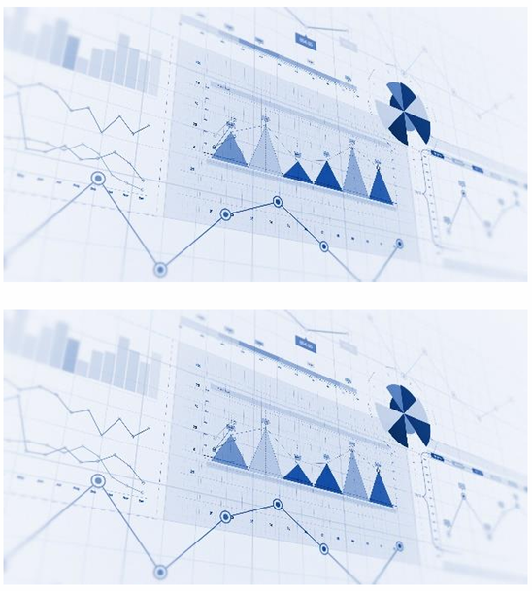



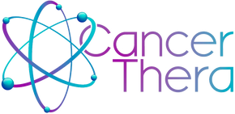

MARCH 2026
12 and 13
FACULTY OF MEDICAL SCIENCES, UNICAMP
Title
Author [1]. Author [2].
Author [1]
[1] Name of the Institution (NI), [2] Name of the Institution (NI), [3] Centro Name of the Institution (NI)
Insert text…
Insert text…
Keywords: Insert text…
Acknowledgements/Funding: Insert text…
PROMOTION
SUPPORT

Slide 2
MARCH 2026
12 and 13
FACULTY OF MEDICAL SCIENCES, UNICAMP
CAR‑T Cell Therapy in the Treatment of Acute Lymphoblastic Leukemia
Maria Clara de Lima Pires [1]. Yasmin Ribeiro Machado [2].
Maria Eduarda Monteiro da Silva [1]
[1] Centro Universitário Serra dos Órgãos (UNIFESO), [2] Centro Universitário Serra dos Órgãos (UNIFESO), [3] Centro Universitário Serra dos Órgãos (UNIFESO)
Acute lymphoblastic leukemia (ALL) is an aggressive hematologic cancer characterized by the uncontrolled proliferation of immature lymphocytes in the bone marrow, leading to hematopoietic failure. Given the need for new therapeutic approaches, this study aims to report the efficacy and safety of CAR‑T therapy in ALL, highlighting its mechanism of action, manufacturing process, and adverse effects. A descriptive methodological approach was used through an integrative literature review of national and international publications indexed in virtual databases such as PubMed, Scielo, the National Cancer Institute (INCA), Instituto Butantã, the American Cancer Society, the Surveillance Research Program (SEER), the Food and Drug Administration (FDA), and Novartis, within the time frame defined for this research, from 1990 to 2024.
CAR‑T cell therapy consists of the genetic modification of the patient’s own T lymphocytes by inserting a chimeric antigen receptor (CAR) capable of identifying and destroying tumor cells. The process begins with the collection of the patient’s T lymphocytes through leukapheresis. The cells are activated in the laboratory and genetically modified using viral vectors (lentiviruses or retroviruses) that introduce the CAR gene. After transduction, CAR‑T cells are expanded and infused back into the patient, where they act by destroying leukemic cells that express the target antigen CD19. This treatment has shown high remission rates, especially in patients who are refractory to conventional therapies. However, clinical effects remain significant, mainly due to adverse events. Cytokine release syndrome (CRS) is a systemic inflammatory response that can cause fever, hypotension, and organ dysfunction, while immune effector cell–associated neurotoxicity syndrome (ICANS) may lead to seizures and cerebral edema. Such complications require strict monitoring and specific therapeutic strategies.
The conclusion of this research demonstrated a high remission rate, particularly in patients with refractory or relapsed B‑cell ALL, improving survival and quality of life. Furthermore, CAR‑T generations have evolved, enhancing immune response, with the second generation standing out for greater efficacy and durability. However, this therapy still faces severe adverse effects, such as cytokine release syndrome and neurotoxicity. In light of this, the use of cytokine blockers, such as tocilizumab, has been explored to minimize these adverse effects. Although it is a promising immunotherapy for the treatment of ALL, access to this therapy in the country remains limited due to its high cost and the lack of necessary infrastructure for its implementation. As a result, the number of specialized centers working with this therapy is restricted, being permitted and authorized only for clinical studies.
Keywords: Acute lymphoblastic leukemia; Cell therapy; CAR‑T cells; Immunotherapy; Oncohematology
Acknowledgements/Funding: The study was supported by the Grant FAPESP #2021/10265-8, Cancer Theranostics Innovation Center
(CancerThera)/CEPID - Centros de Pesquisa, Inovação e Difusão).
PROMOTION
SUPPORT

